Slide 1
Spatial Filters in Practical Use
Haonan Wu

Slide 2
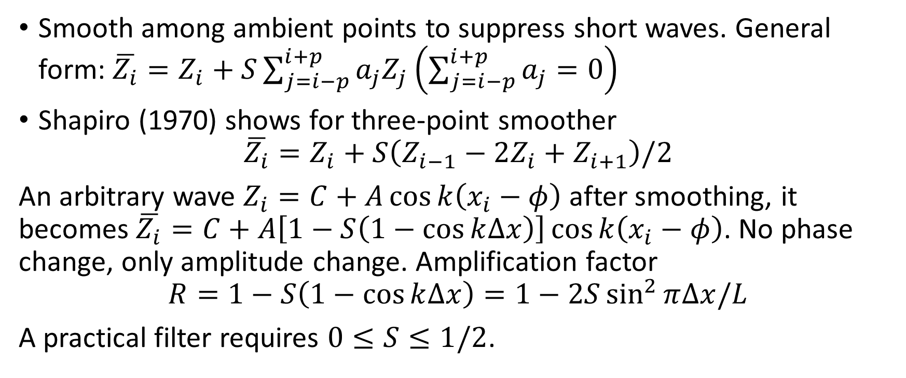
Shapiro Filter
Smooth among ambient points to suppress short waves. General form: $\overline{Z_{i}}=Z_{i}+S\sum_{j=i−p}^{i+p}{a_{j}Z_{j}}\left(\sum_{j=i−p}^{i+p}{a_{j}}=0\right)$
Shapiro (1970) shows for three-point smoother
$$\overline{Z_{i}}=Z_{i}+S\left(Z_{i−1}−2Z_{i}+Z_{i+1}\right)/2$$
An arbitrary wave $Z_{i}=C+A\cos{k\left(x_{i}−φ\right)}$ after smoothing, it becomes $\overline{Z_{i}}=C+A\left[1−S\left(1−\cos{k∆x}\right)\right]\cos{k\left(x_{i}−φ\right)}$. No phase change, only amplitude change. Amplification factor
$$R=1−S\left(1−\cos{k∆x}\right)=1−2S\sin^{2}{π∆x/L}$$
A practical filter requires $0≤S≤1/2$.

Slide 3
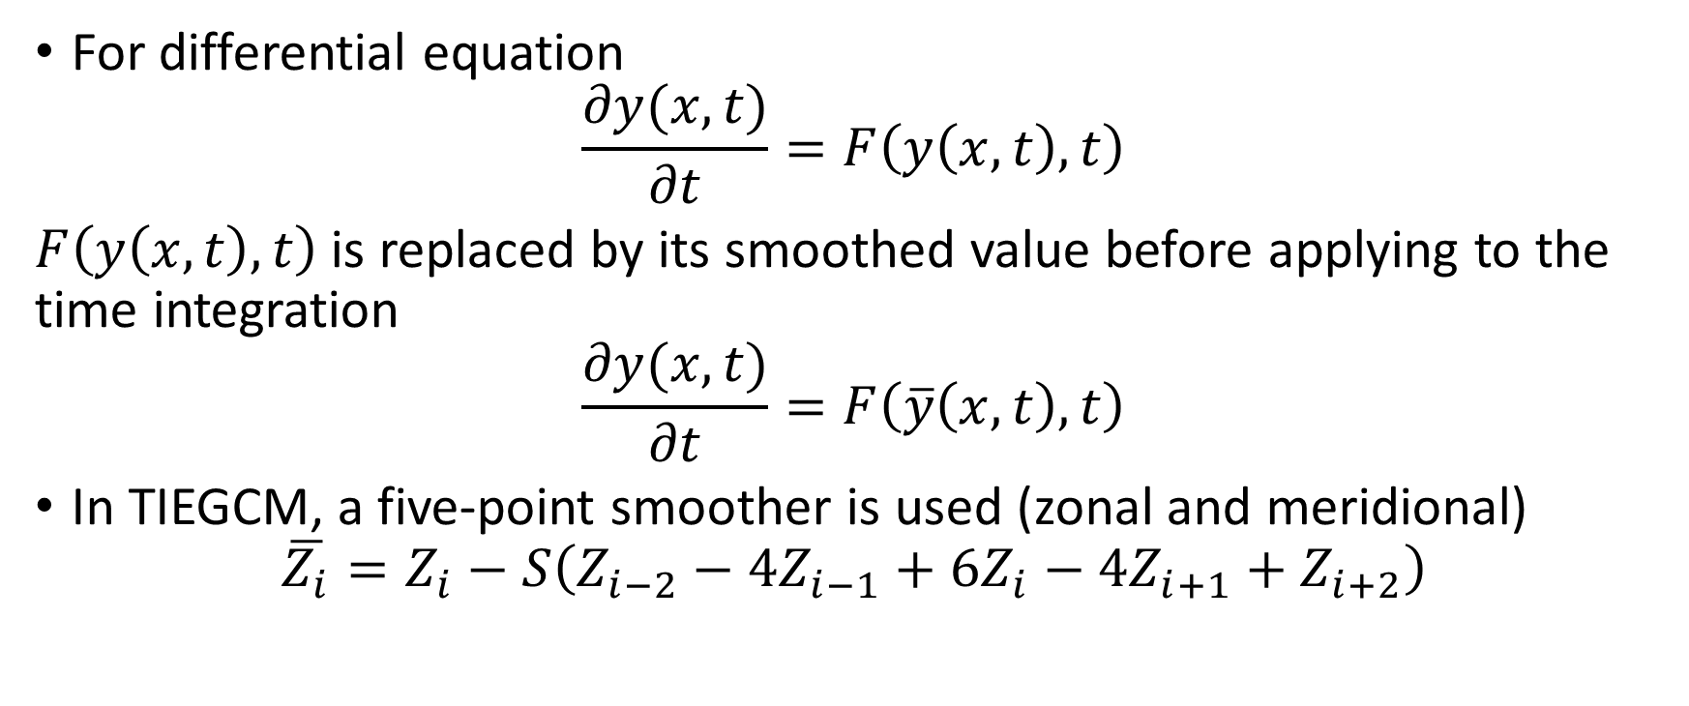
Shapiro Filter
For differential equation
$$\frac{∂y(x,t)}{∂t}=F\left(y\left(x,t\right),t\right)$$
$F\left(y\left(x,t\right),t\right)$ is replaced by its smoothed value before applying to the time integration
$$\frac{∂y(x,t)}{∂t}=F\left(\overline{y}\left(x,t\right),t\right)$$
In TIEGCM, a five-point smoother is used (zonal and meridional)
$$\overline{Z_{i}}=Z_{i}−S\left(Z_{i−2}−4Z_{i−1}+6Z_{i}−4Z_{i+1}+Z_{i+2}\right)$$

Slide 4
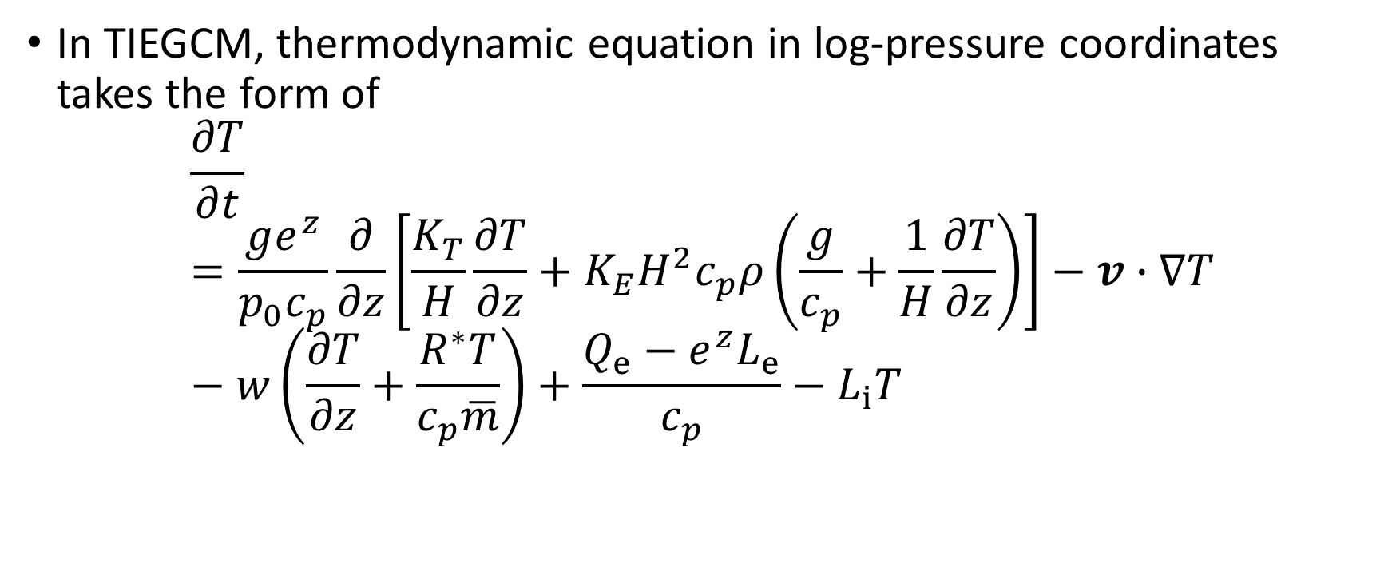
Shapiro Filter
In TIEGCM, thermodynamic equation in log-pressure coordinates takes the form of
$$\frac{∂T}{∂t}=\frac{ge^{z}}{p_{0}c_{p}}\frac{∂}{∂z}\left[\frac{K_{T}}{H}\frac{∂T}{∂z}+K_{E}H^{2}c_{p}ρ\left(\frac{g}{c_{p}}+\frac{1}{H}\frac{∂T}{∂z}\right)\right]−v∙∇T−w\left(\frac{∂T}{∂z}+\frac{R^{∗}T}{c_{p}\overline{m}}\right)+\frac{Q_{e}−e^{z}L_{e}}{c_{p}}−L_{i}T$$

Slide 5
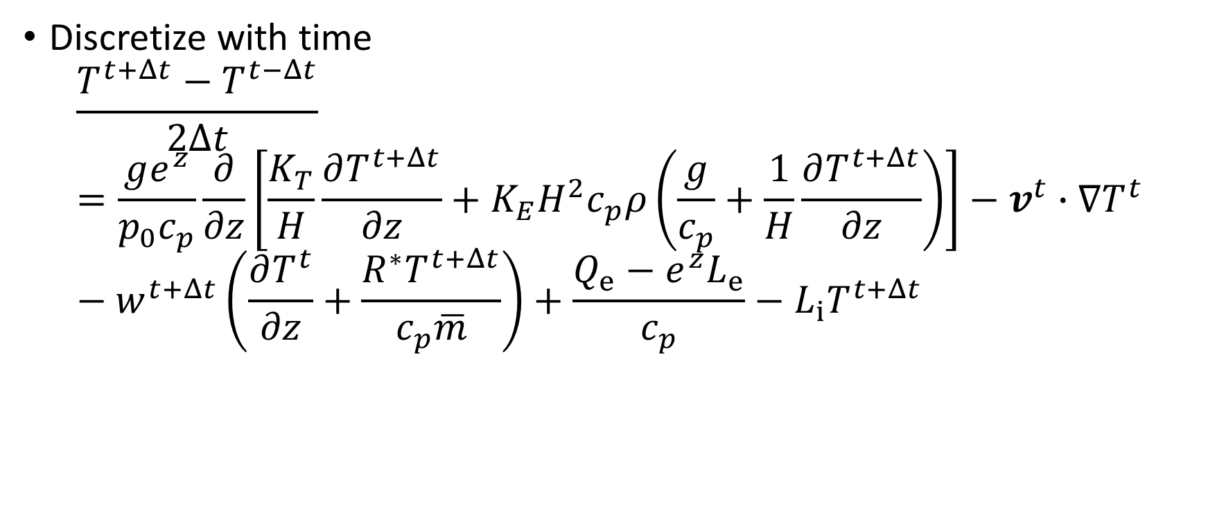
Shapiro Filter
Discretize with time
$$\frac{T^{t+Δt}−T^{t−Δt}}{2Δt}=\frac{ge^{z}}{p_{0}c_{p}}\frac{∂}{∂z}\left[\frac{K_{T}}{H}\frac{∂T^{t+Δt}}{∂z}+K_{E}H^{2}c_{p}ρ\left(\frac{g}{c_{p}}+\frac{1}{H}\frac{∂T^{t+Δt}}{∂z}\right)\right]−v^{t}∙∇T^{t}−w^{t+Δt}\left(\frac{∂T^{t}}{∂z}+\frac{R^{∗}T^{t+Δt}}{c_{p}\overline{m}}\right)+\frac{Q_{e}−e^{z}L_{e}}{c_{p}}−L_{i}T^{t+Δt}$$

Slide 6
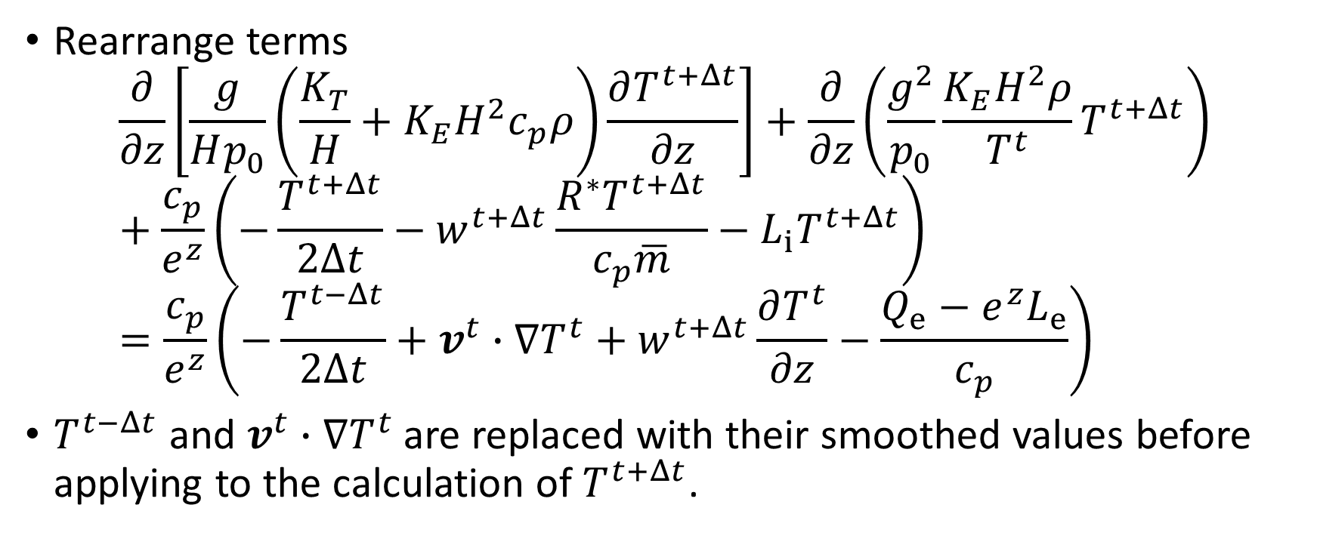
Shapiro Filter
Rearrange terms
$$\frac{∂}{∂z}\left[\frac{g}{Hp_{0}}\left(\frac{K_{T}}{H}+K_{E}H^{2}c_{p}ρ\right)\frac{∂T^{t+Δt}}{∂z}\right]+\frac{∂}{∂z}\left(\frac{g^{2}}{p_{0}}\frac{K_{E}H^{2}ρ}{T^{t}}T^{t+Δt}\right)+\frac{c_{p}}{e^{z}}\left(−\frac{T^{t+Δt}}{2Δt}−w^{t+Δt}\frac{R^{∗}T^{t+Δt}}{c_{p}\overline{m}}−{L_{i}T}^{t+Δt}\right)=\frac{c_{p}}{e^{z}}\left(−\frac{T^{t−Δt}}{2Δt}+v^{t}∙∇T^{t}+w^{t+Δt}\frac{∂T^{t}}{∂z}−\frac{Q_{e}−e^{z}L_{e}}{c_{p}}\right)$$
$T^{t−Δt}$ and $v^{t}∙∇T^{t}$ are replaced with their smoothed values before applying to the calculation of $T^{t+Δt}$.

Slide 7
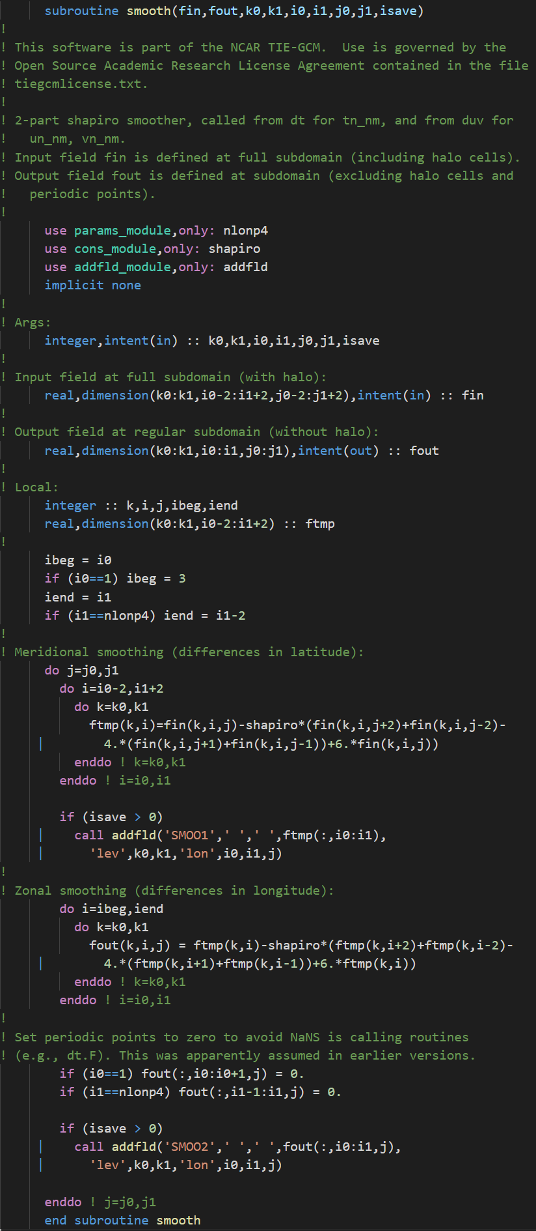
Shapiro Filter
Meridional smoothing
Zonal smoothing

Slide 8
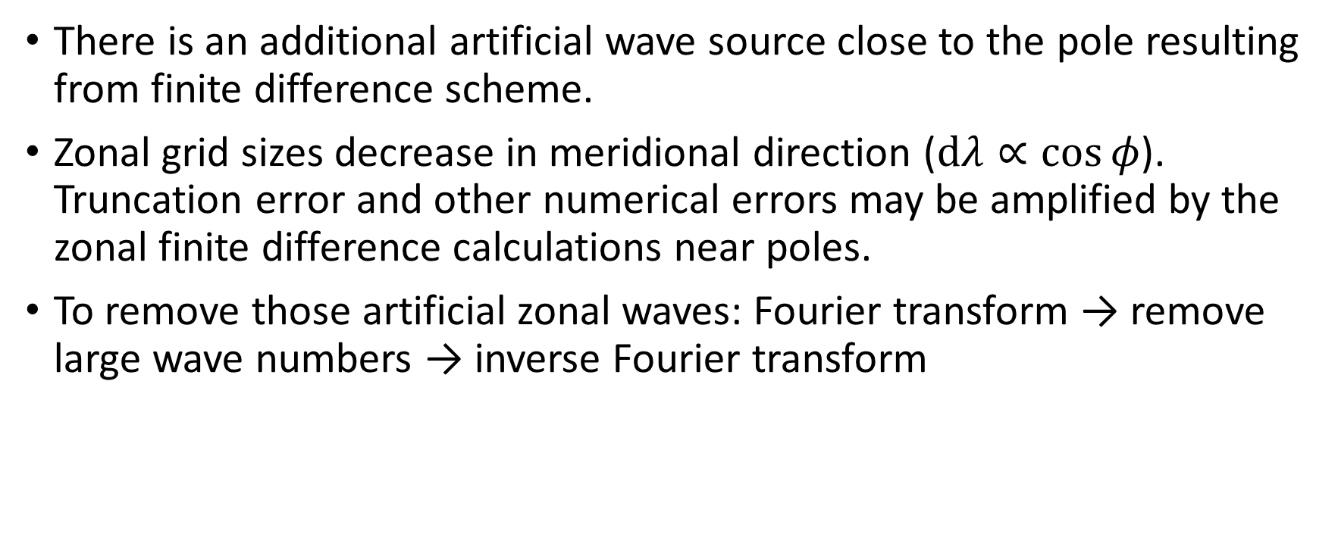
Fourier Filter
There is an additional artificial wave source close to the pole resulting from finite difference scheme.
Zonal grid sizes decrease in meridional direction ($dλ∝\cos{φ}$). Truncation error and other numerical errors may be amplified by the zonal finite difference calculations near poles.
To remove those artificial zonal waves: Fourier transform → remove large wave numbers → inverse Fourier transform

Slide 9
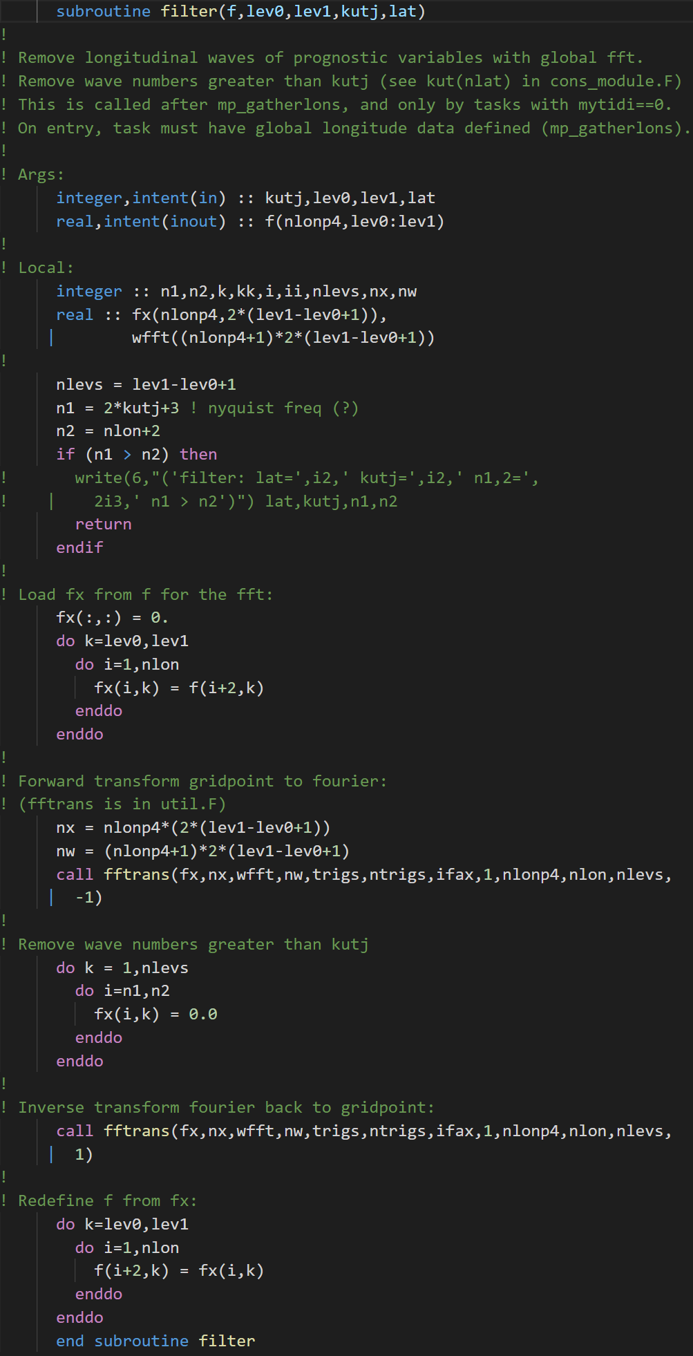
Fourier Filter
Fourier transform
Remove waves
Inverse Fourier transform

Slide 10
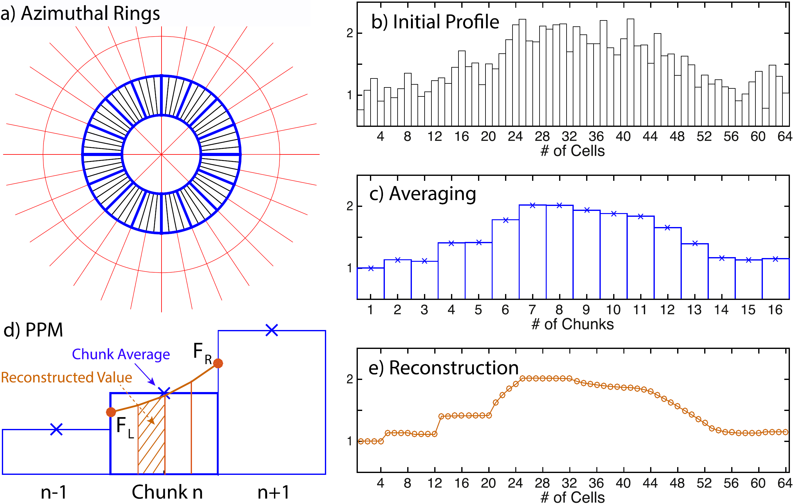
Ring Filter
In most cases, using Fourier transform to remove small scale waves is overcomplicated, piece wise average is sufficient.
Zhang et al., 2019

Slide 11
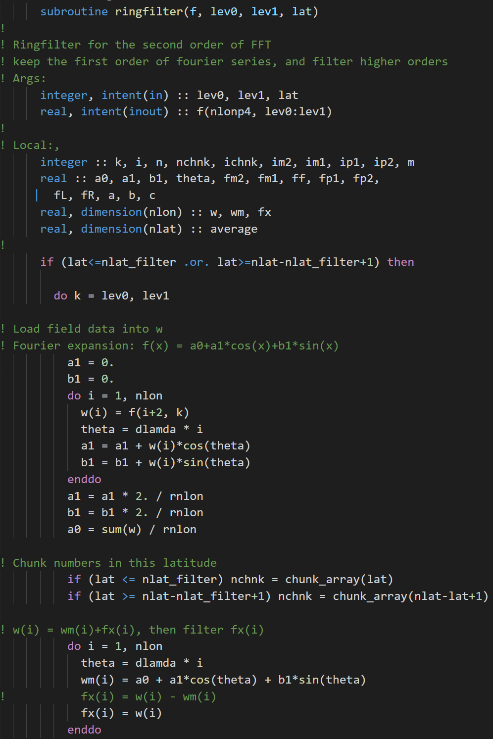
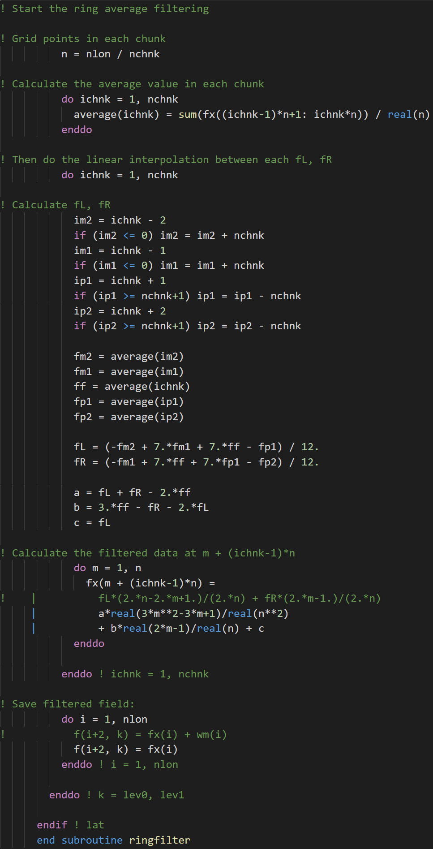
Ring Filter
Average within each chunk
Pre-average preparation
Reconstruct using F_{L}, F_{M}, F_{R}

